Slide 1
Social Footprint
Using Profile Attributes to Determine Vulnerability in Online Social Networks
Group 13
Hamza Karachiwala
Kedar Amrolkar
Mickey Vellukunnel

Slide 2
SOCIAL FOOTPRINT PROFILE INFORMATION AGGREGATED FROM MULTIPLE OSN ACCOUNTS
How much aggregated information do we disclose online through multiple Online Social Networking accounts?
How safe is it to disclose that information? Can we measure the risk associated with it?
Can we identify a way to reduce disclosed information but keep visibility high?

Slide 3


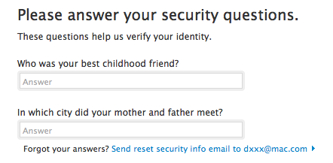
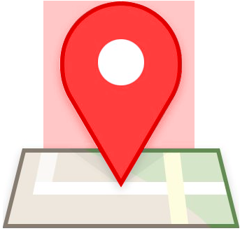



MOTIVATION
More comprehensive profile out there than we expect.
Identity thefts
Password Recovery
Stalking / Harassment
Sex crimes

Slide 4
PROPOSED SOLUTION
Use OSN APIs for developers to fetch profile information of a user.
Aggregate data from all APIs to create the social footprint.
Have weights associated with relevant/crucial available public attributes.
Calculate total weight of the footprint and compare with a threshold.
Identify attributes that could be left out to reduce weight (associated with risk) with less effect on visibility.

Slide 5








SOCIAL NETWORKS OUT THERE
Facebook - Most personal data disclosed due to popularity.
LinkedIn - Professional data usually not available on Facebook.
Quora - Also popular and categorized.
Instagram - Images.
YouTube - Videos.
Google+ - Does anybody use it.
Twitter - Followers.
Pinterest - Interests.

Slide 6
WEIGHTS FOR PROFILE ATTRIBUTES
Weights based on risk associated with attributes.
The riskier an attribute the more weight it will have.
These could be risks of
Password recovery
Identity theft & Profiling
PII - Personal Identification Information (using Cross Site Linking)

Slide 7
How we assign weights to attributes
Look at previous research to see how different fields are used in different sites or across sites.
Use the balance beam approach to assign weights based on these percentages/records.
Use the weighted averages approach to decide how much risk a particular sub-category of crime warrants.

Slide 8
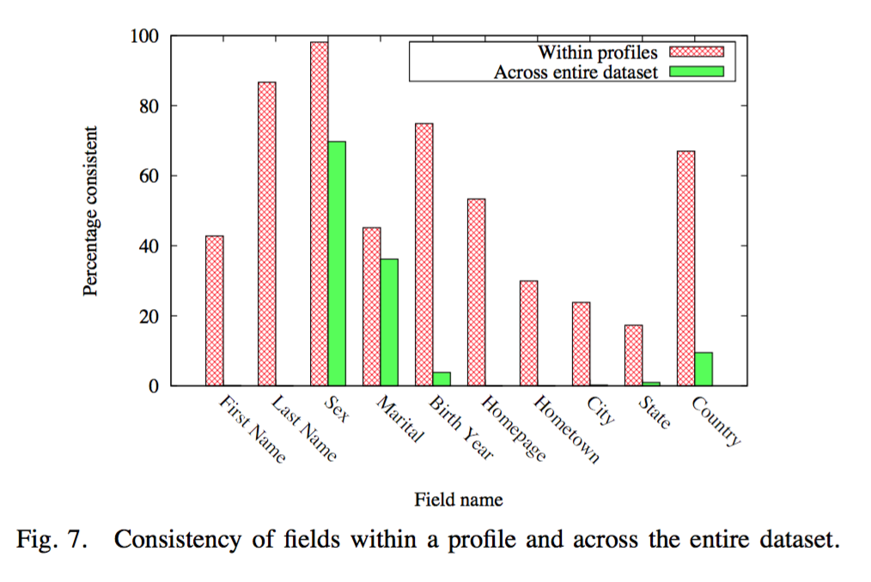
Example

Slide 9
Example of weights calculated...
Field | Weight associated
Email ID | 0.35
Name | 0.21
Profile picture | 0.17
Date of birth | 0.12
Zipcode | 0.07
Hometown | 0.06
Age | 0.01
Location | 0.01

Slide 10

WHY PASSWORD RECOVERY
Common misconception; I’ve got a strong password, my profile is safe.
What about password recovery questions?
Sarah Palin’s “hacked” email account.
80% people have admitted to using recoveries
Not as safe as other recovery techniques
We generally choose easy to remember questions.

Slide 11
PASSWORD RECOVERY QUESTIONS
City of Birth?
First School?
Mothers maiden name?
First kiss from?
Favourite restaurant, actor, artist?
Wedding Reception Venue?
Father’s middle name?
Pets Name?
First Car?
First manager at job?
Vehicle registration number?
Wedding Reception Venue?
Parents’ birth year?

Slide 12
TECH STACK
PHP - Use the APIs provided by OSNs to fetch user data
Facebook
LinkedIn
MySQL - Store the footprint and weights of attributes
Store footprint weights in the backend - statistical information
Calculate the weight and compare with threshold on server
Apache now, host later
We could move from localhost to the cloud if time permits

Slide 13
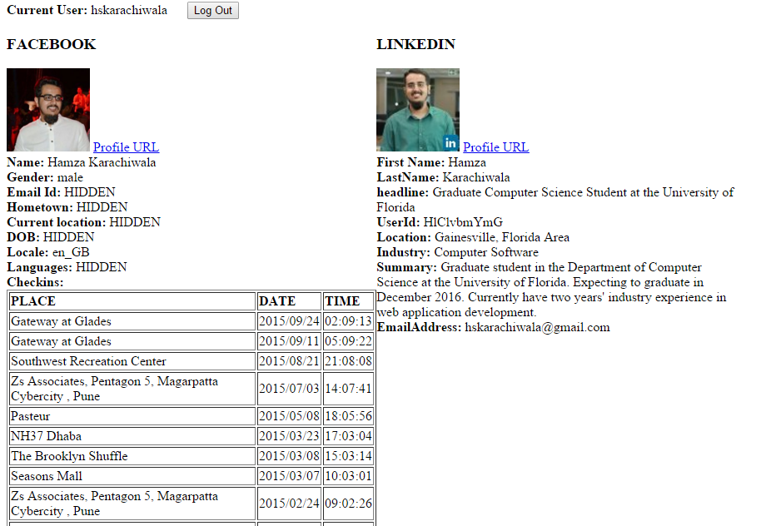
STALKING THE HAMZA
Hidden from FB, visible on LinkedIn
Email
Location

Slide 14
What has changed in our scope?
Challenges?
Deriving weights from crime records.
Giving risk assessments for “friend” visible information.
Informing the user of every type of risk associated with a particular field.

Slide 15
ROADMAP
Use OSN APIs for developers to fetch data for a user - In Progress
Aggregate data from all APIs to create the total footprint - In Progress
Have weights associated with all attributes - In Progress
Calculate total weight of the footprint and compare with a threshold - Pending
Identify attributes that could be left out to reduce weight with less effect on visibility- Pending

Slide 16
QUESTIONS AND SUGGESTIONS?

